Slide 1
Digital Portfolio
STUDENT NAME: Meenakshe B
REGISTER NO AND NMID: 222402621 / asunm161222402621
DEPARTMENT: Computer Science With Data Science
COLLEGE: Prince Shri Venkateshwara Arts and Science collage/ Madras UNIVERSITY

Slide 2
PROJECT TITLE
Digital Portfolio

Slide 3


AGENDA
Problem Statement
Project Overview
End Users
Tools and Technologies
Portfolio design and Layout
Features and Functionality
Results and Screenshots
Conclusion
Github Link
3/21/2024 Annual Review

Slide 4

PROBLEM STATEMENT Students often struggle to present their projects, skills, and achievements in a professional online format. A digital portfolio (Webfolio) solves this by providing a structured and appealing platform.

Slide 5

PROJECT OVERVIEW Webfolio is a digital portfolio website designed to present academic, personal, and project details in an interactive manner. It enhances visibility and makes recruitment easier.

Slide 6

END USERS Students and Graduates - Job Recruiters - Academic Institutions - Personal Branding Enthusiasts

Slide 7

TOOLS AND TECHNIQUES
HTUsed to create the structure of the portfolio (headings, paragraphs, sections).
CSS → Used to add design, colors, and styling.
GitHub Pages → Used to host the portfolio online and share it easily.
ML →

Slide 8
POTFOLIO DESIGN AND LAYOUT
- Home Page with Introduction
- About Me Section
- Skills and Achievements
- Project Showcase
Contact Page
8

Slide 9
FEATURES AND FUNCTIONALITY
- Responsive design
- Easy navigation
- Interactive project gallery
- Contact form integration
- Links to GitHub and LinkedIn

Slide 10
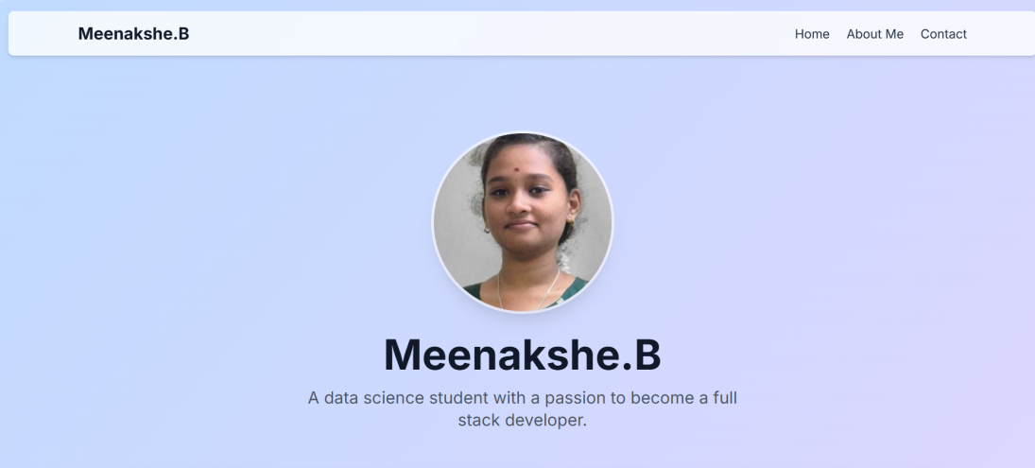
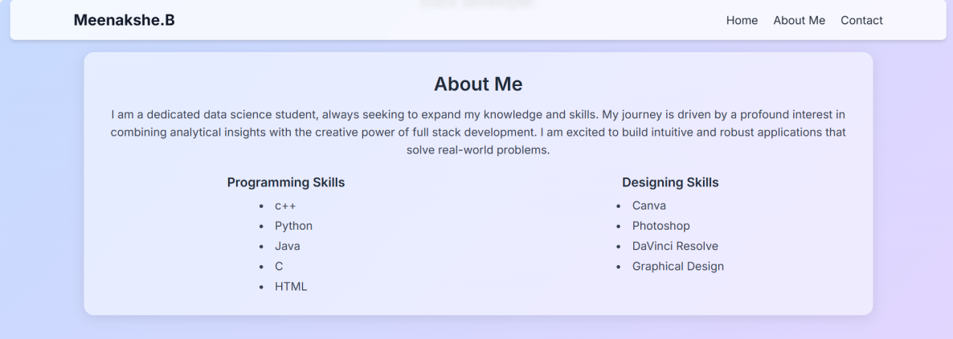

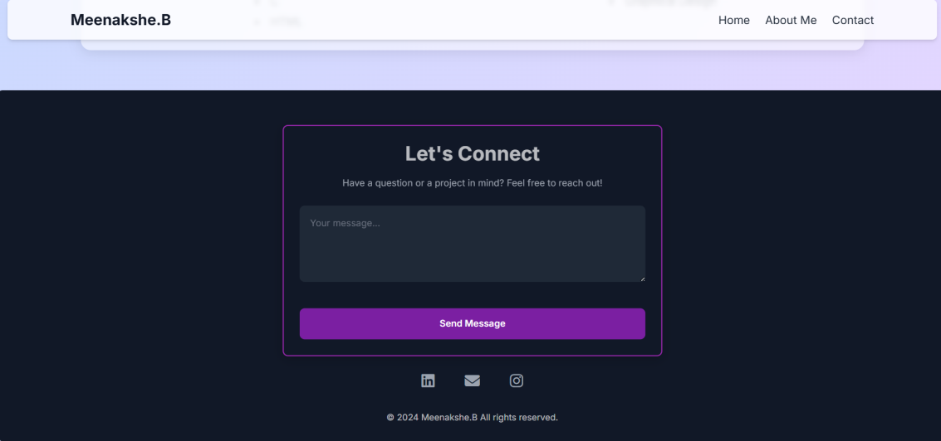
RESULTS AND SCREENSHOTS
3/21/2024 Annual Review
10

Slide 11
CONCLUSION
For more details and support, please contact:
Name: Meenakshe B
Register No: 222402621
NM/Username: asunm161222402621
College: Prince Shri Venkateshwara Arts and Science College, Gowrivakkam, Chennai
GitHub Link: https://meenakshe551.github.io/TNSDC-FWD-DP/
11

